Slide 1
Introduction to “Xcos”
An Alternative to MATLAB-Simulink

Slide 2
What is Xcos?
A Scilab connected object simulator
Used for block diagram simulation
Excellent GUI for Data processing

Slide 3
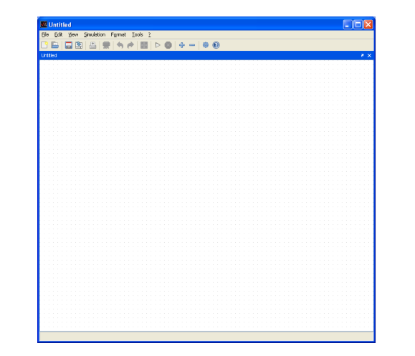
Xcos Window
An editing window which is the working space to design diagrams

Slide 4
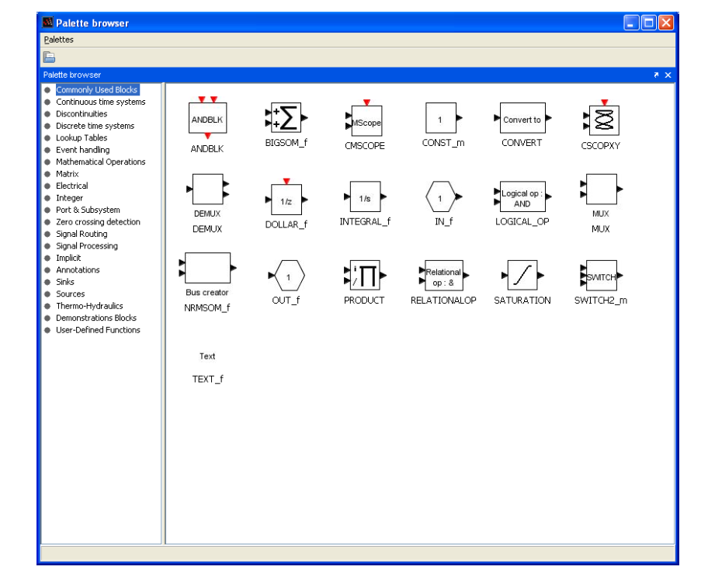
Xcos Palette browser
A palette browser which provides a set of predefined blocks

Slide 5
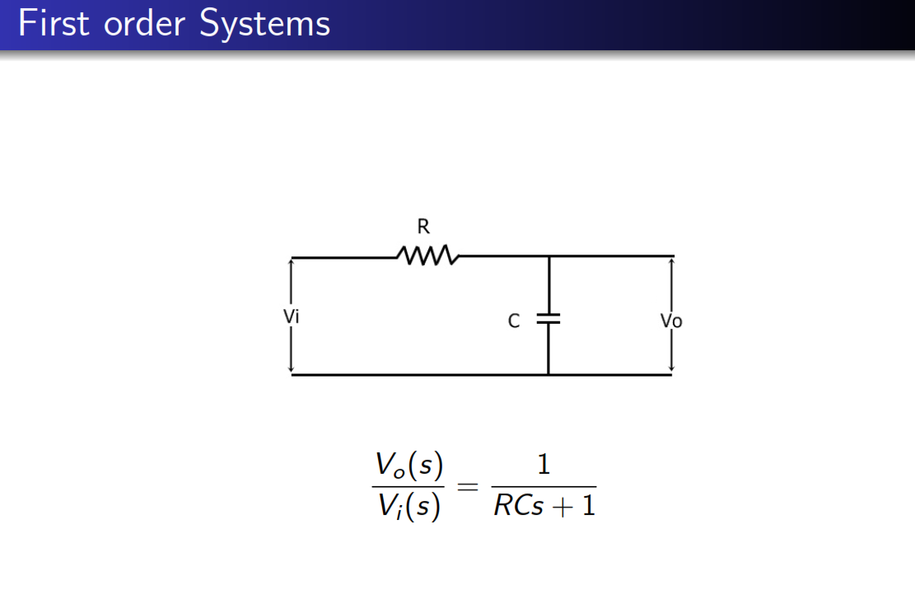

Slide 6
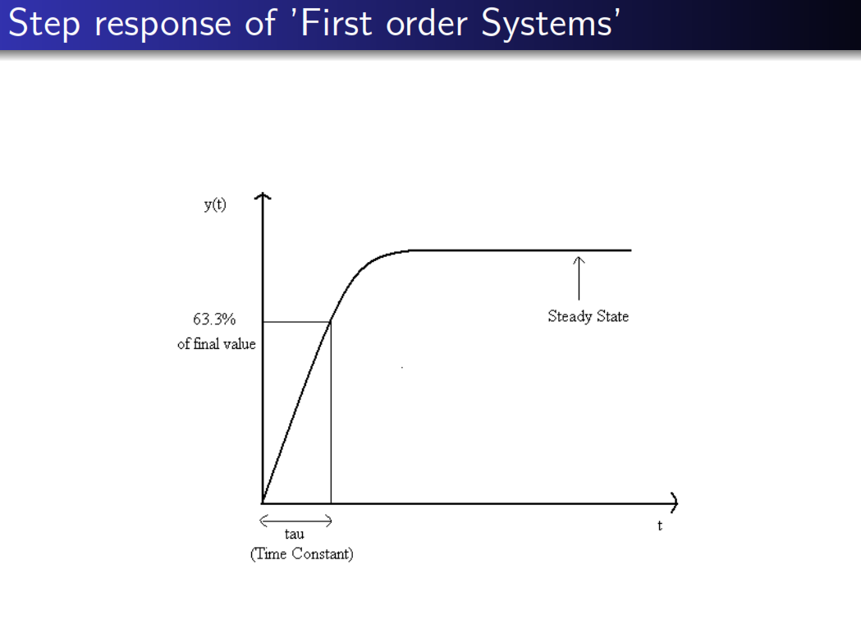

Slide 7
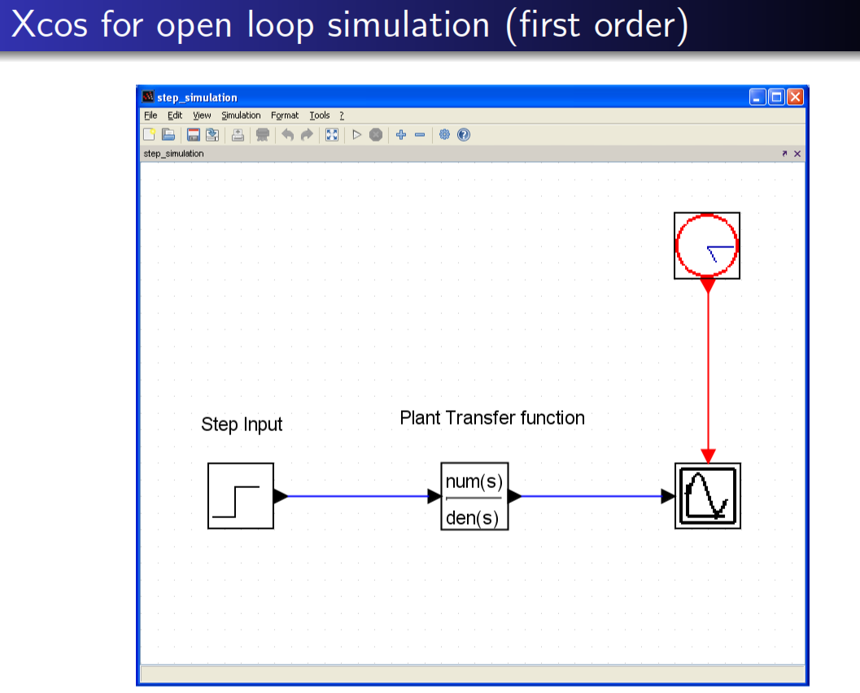

Slide 8
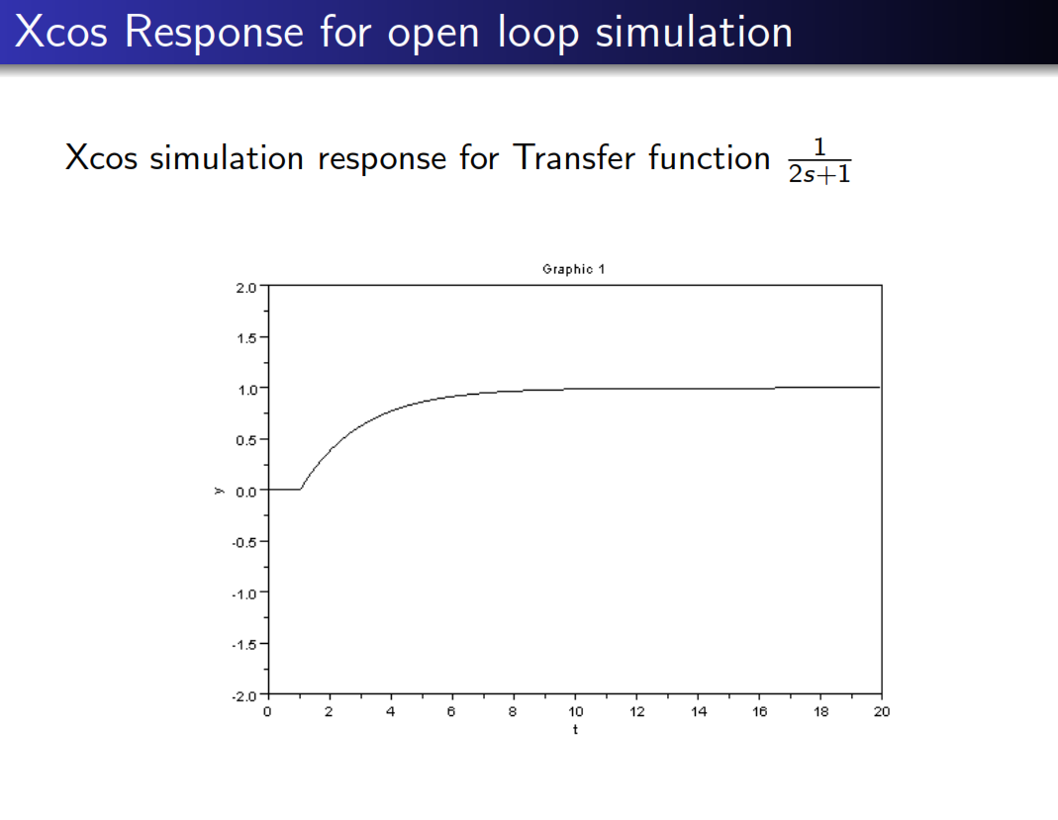

Slide 9
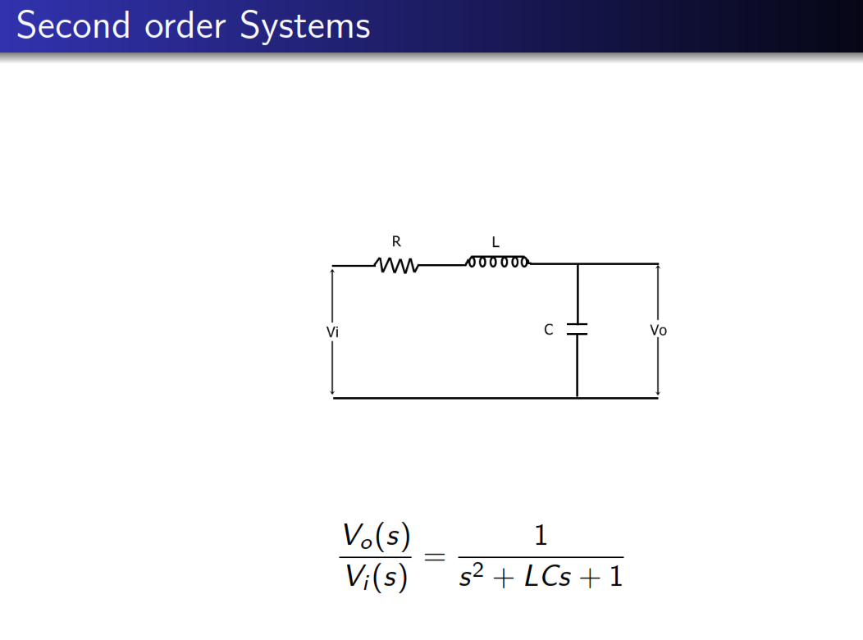

Slide 10
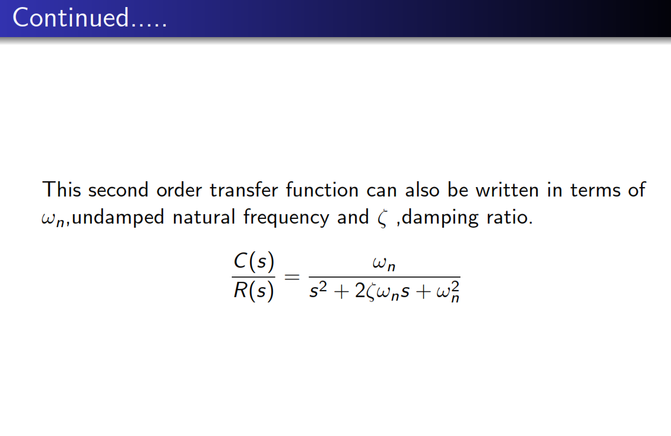

Slide 11
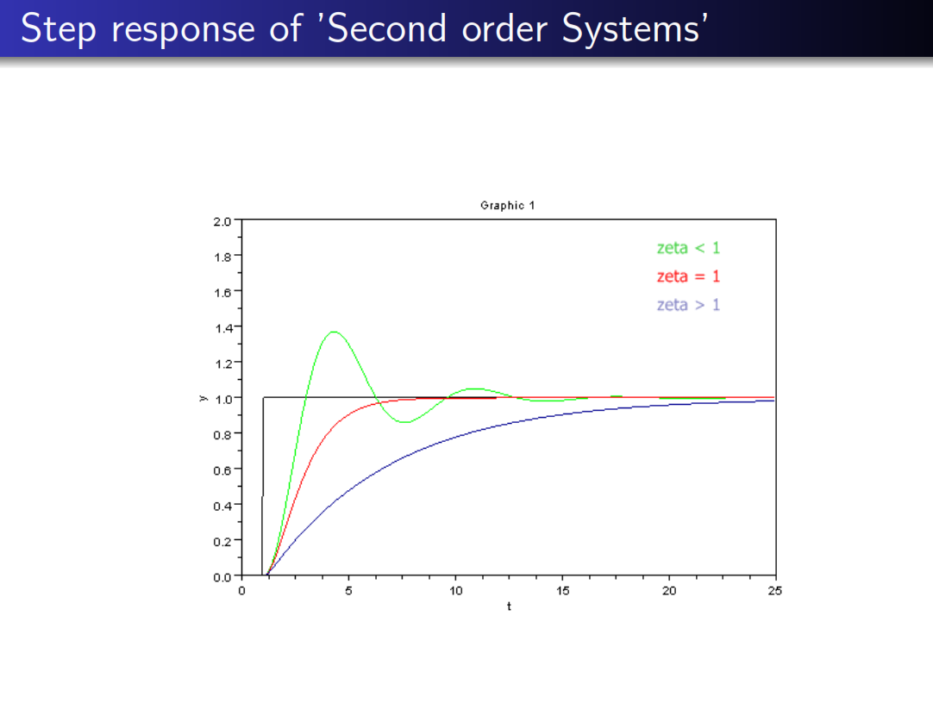

Slide 12


Slide 13
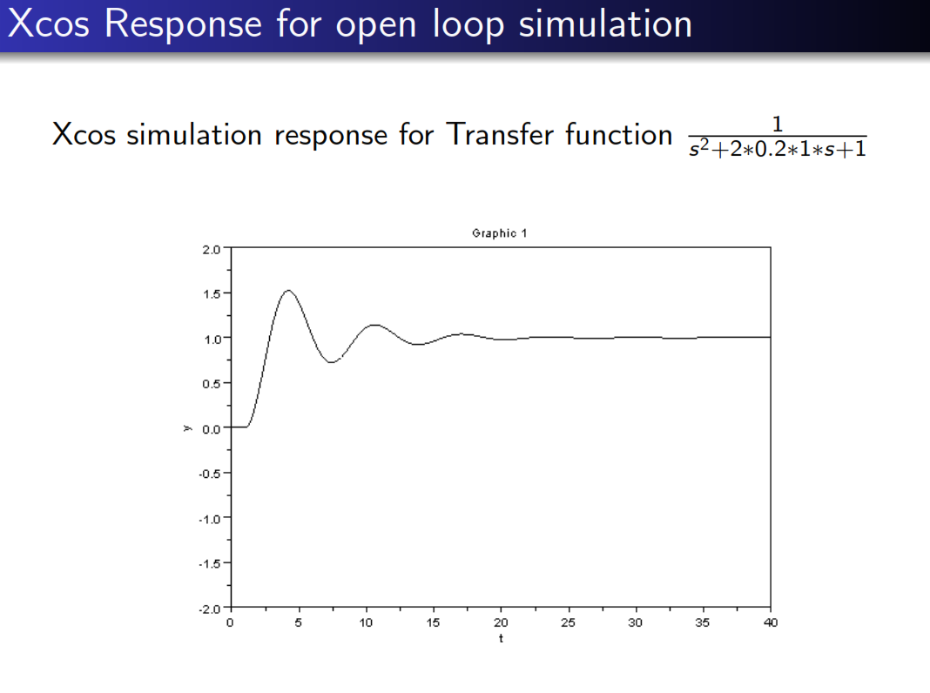

Slide 14
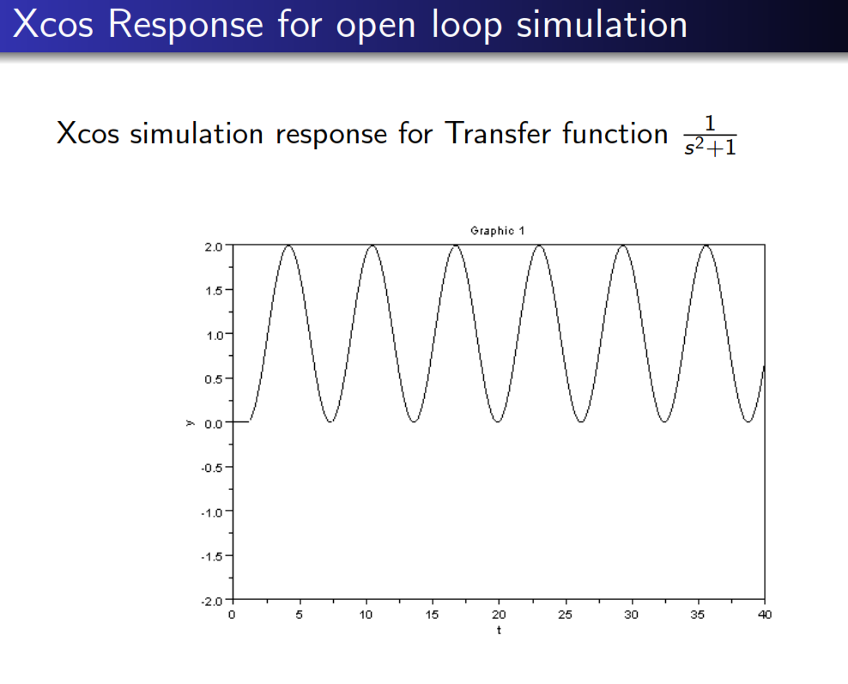

Slide 15
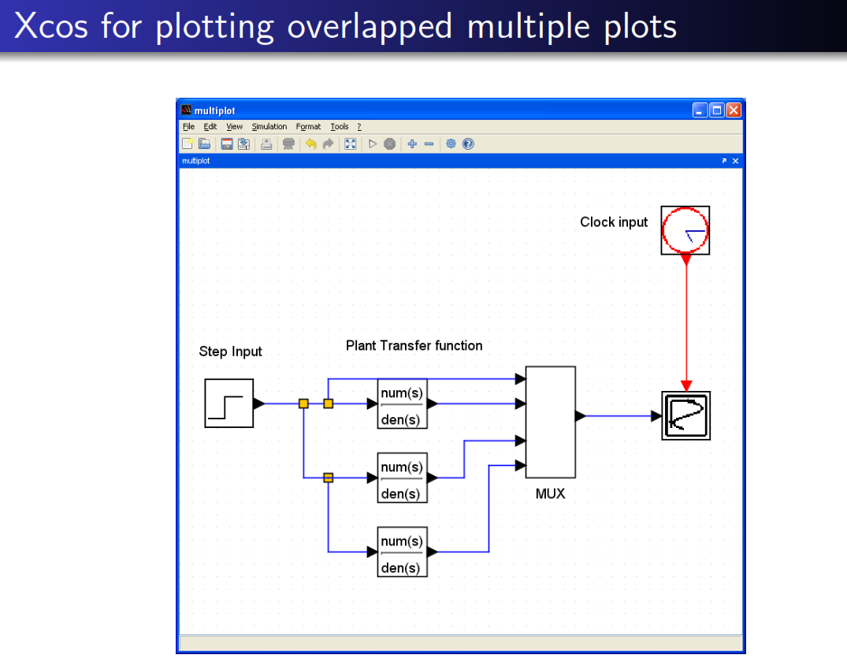

Slide 16
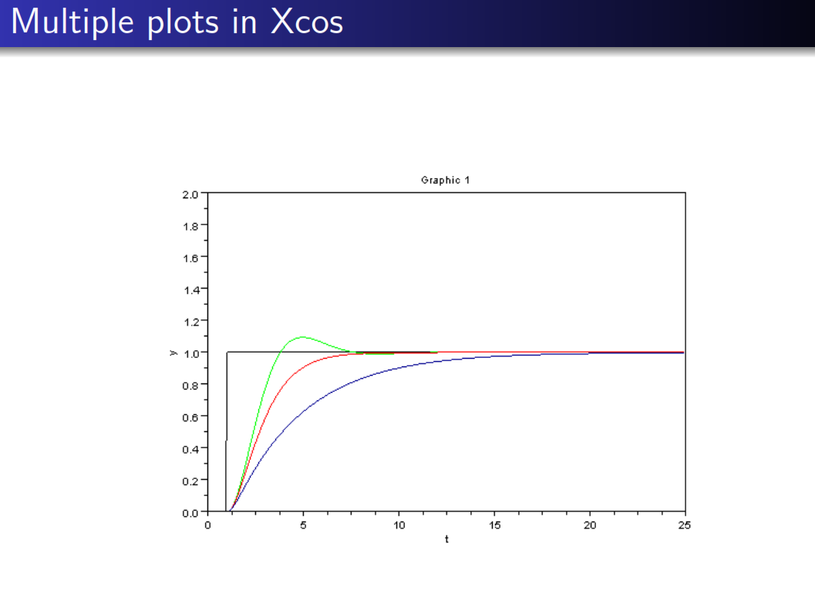

Slide 17
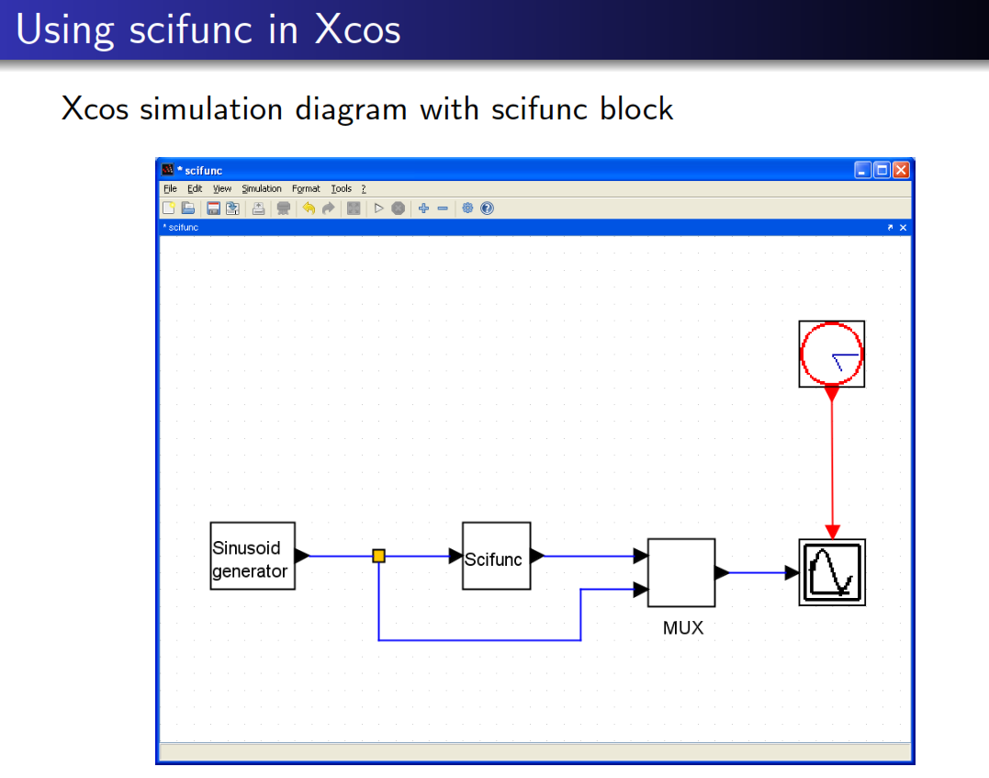

Slide 18
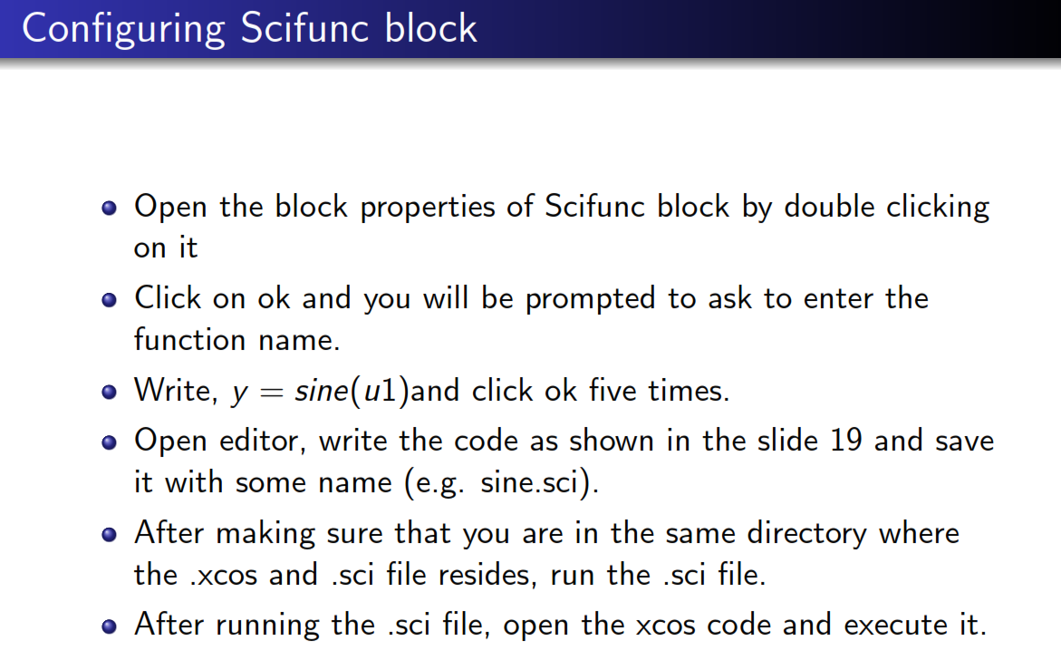

Slide 19
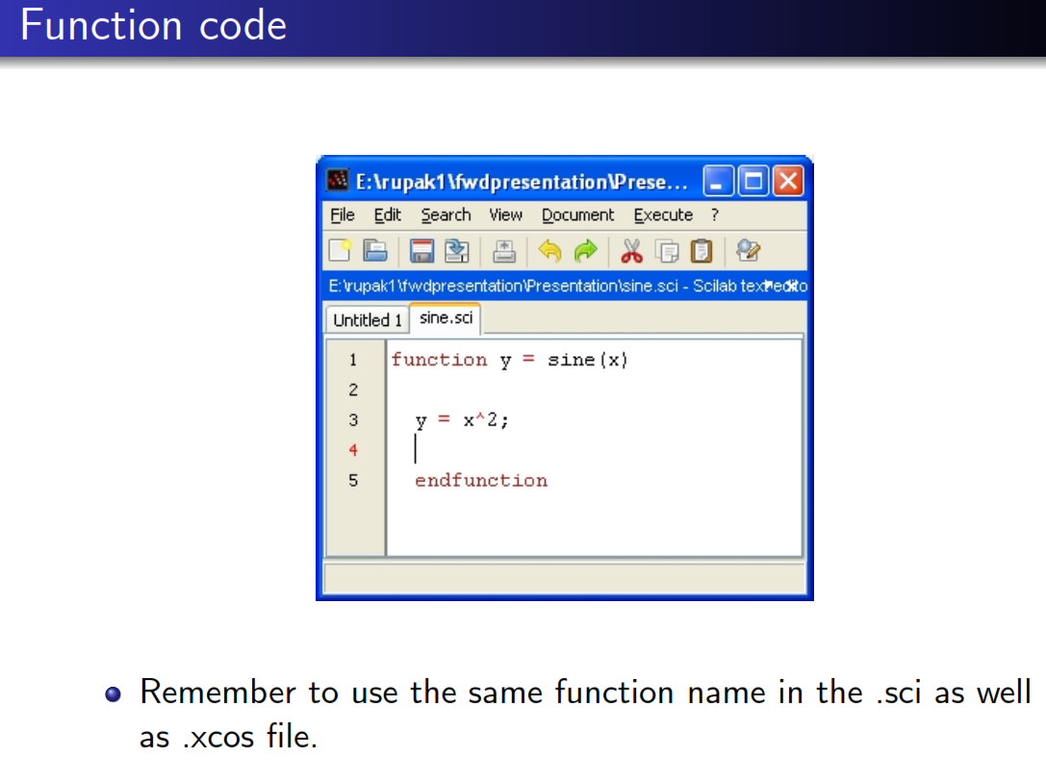

Slide 20
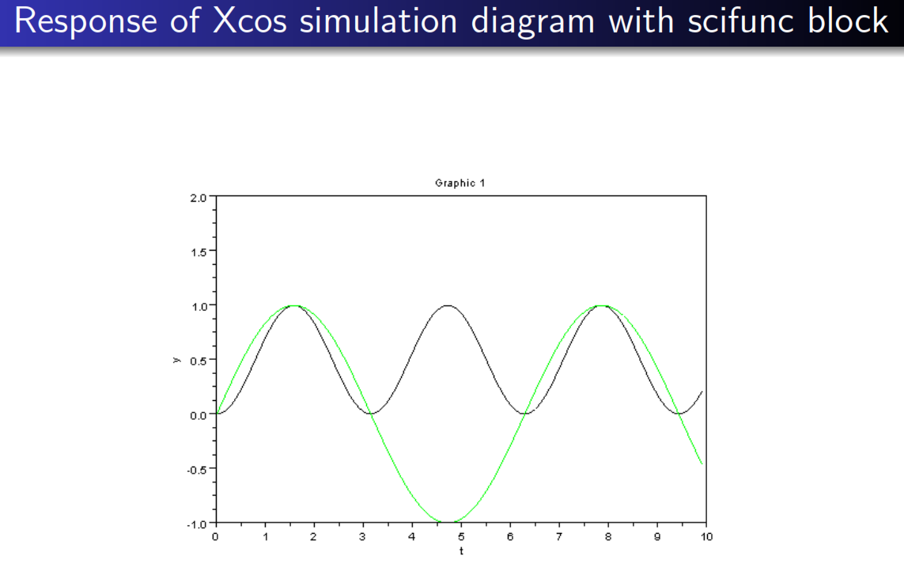

Slide 21
Examples of Xcos
scilab lab\xcos programs

